Slide 1
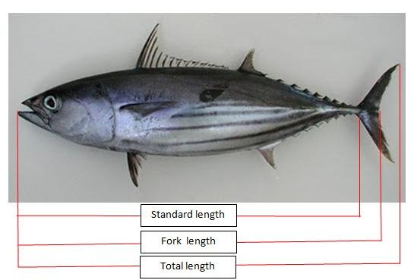
Fish measurement prediction

Slide 2
About dataset ?
The fish measuring prediction dataset you are referring to seems to be the "Fish Measurements" dataset, which is commonly used for regression analysis and machine learning algorithms. This dataset includes the following features:
* Species: The species of the fish (e.g., Bream, Roach, Pike, etc.).
* Weight: The weight of the fish, measured in grams.
* Length1: The length of the fish from the tip of its head to the base of its tail, measured in centimeters
* Length2: The length of the fish from the tip of its head to the end of its body, measured in centimeters
* Length3: The length of the fish from the tip of its head to the end of its tail, measured in centimeters
* Height: The height of the fish, measured in centimeters
* Width: The width of the fish, measured in centimeters
This dataset is often used to train models to predict the weight of a fish based on its length, height, and width. The species of the fish is also included as a feature, as different species may have different weight-to-length ratios.
Note - Here we have got various types of species as mentioned above

Slide 3
Workflow -
1) Data set loading
2) Data pre-processing - understanding the data and checking data frame of the data, checking if any null values or missing values are there and drop duplicates and doing some visualization to get more insights of the data
3) Doing some eda – checking outliers on numerical column and checking the columns normally distributed or not and doing some bi-variate analysis
4) Feature selection – drop unwanted columns if it is not contributing to model building
5) Applying regression and model construction – importing necessary library and doing train test split
6) Checking algoredium performance through regression metrics –
7) Checking accuracy of model

Slide 4
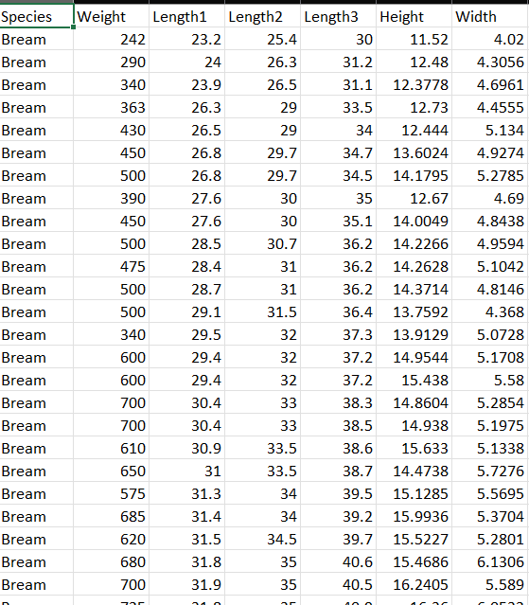
Data set -
Categorical column – species
Numerical column – weight(target-variable) length1, length2, length3, height, width

Slide 5
Data preprocessing –
Checking head value
Checking description of the data
Checking datatype of the data
Checking the shape of the data
Checking null values
Checking duplicate value in the data and many more….
Doing some basic eda -
Univariate analysis
Checking outliers
Doing normality test
Grouping the data for better analysis
Bivariate analysis
Checking tallest & weighted species through bar plot
Checking correlation between the values

Slide 6
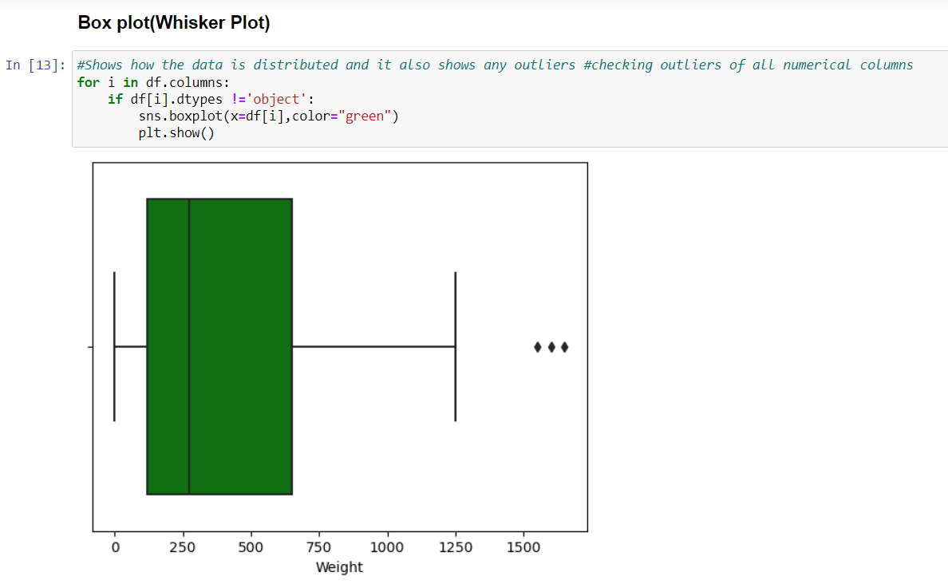
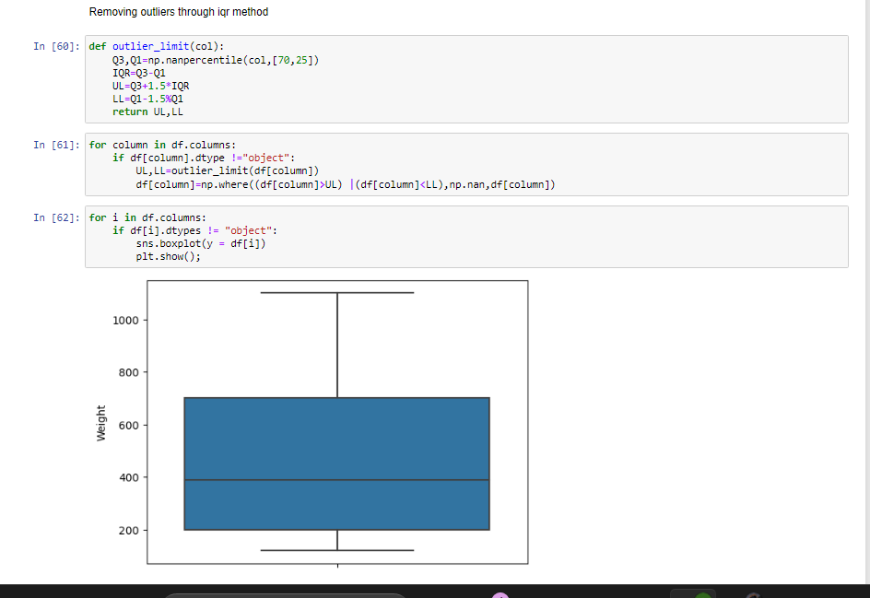
1) Checking outliers -
Removing outliers through iqr method -
Iqr method is one of the method which is used to remove extreme values In the given dataset

Slide 7
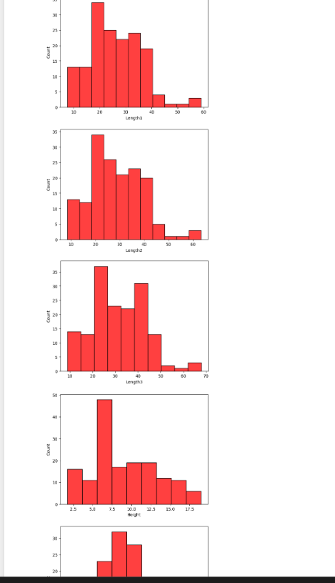
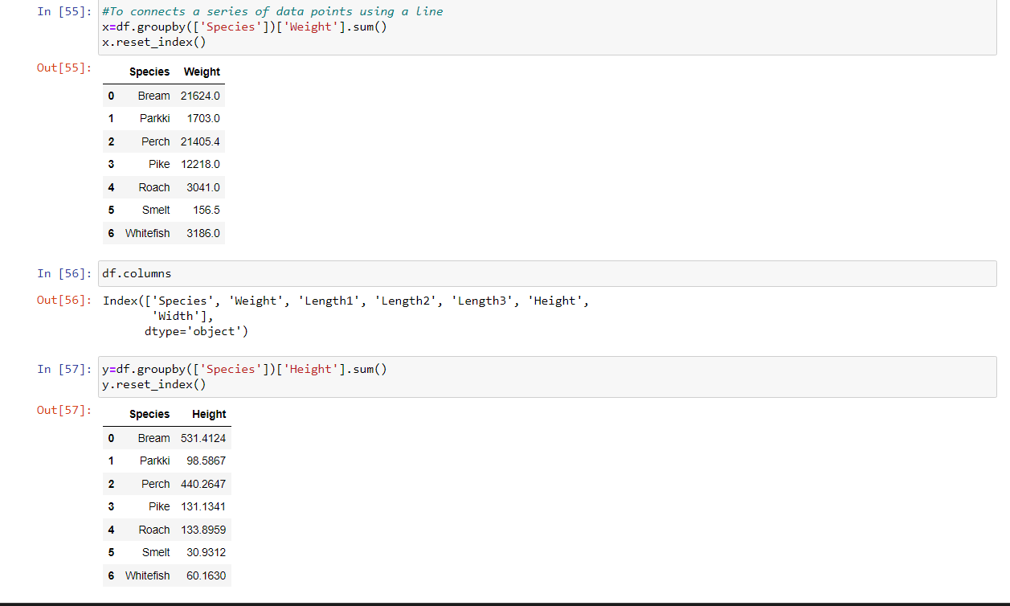
Doing normality test -
Here we can observe that almost all numerical column is normally distributed
Grouping the data based weight and length

Slide 8
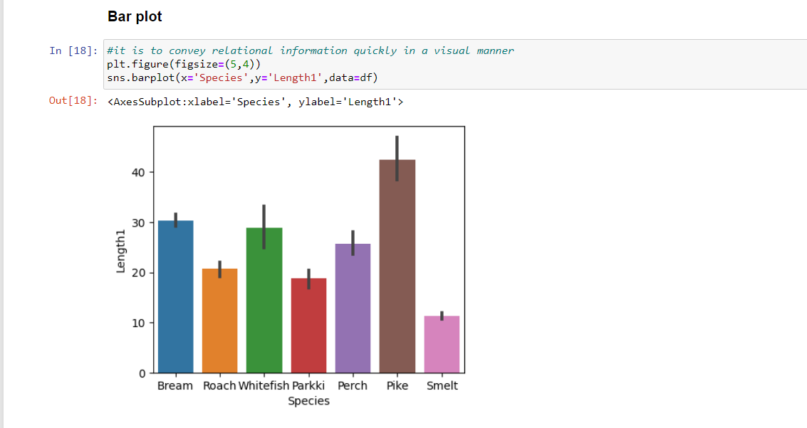
Doing some univariate analysis -
Here we can observe that pike is tallest species in this given dataset

Slide 9
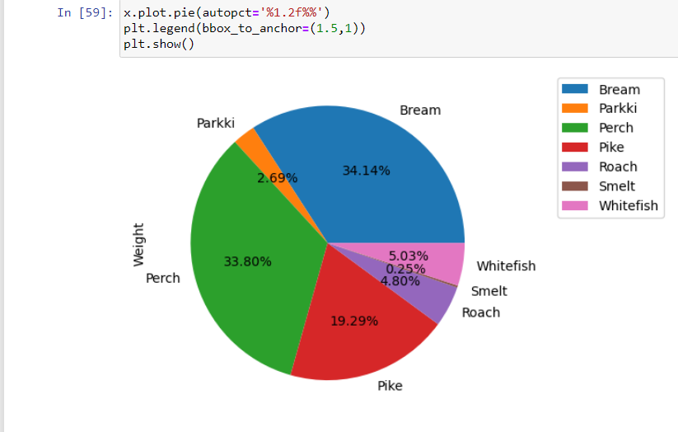
Here we can observe that bream and perch is contributing more percentage in this dataset

Slide 10
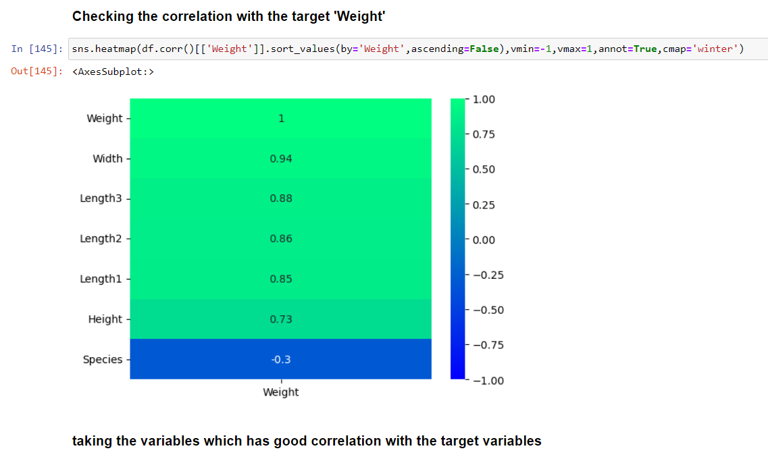
Checking correlation by plotting heatmap -
Here we can observe that almost all the column have got positive relationship between the values aspect species. Species is exceptional case because we used one hot encoding there to convert categorical to numerical value

Slide 11
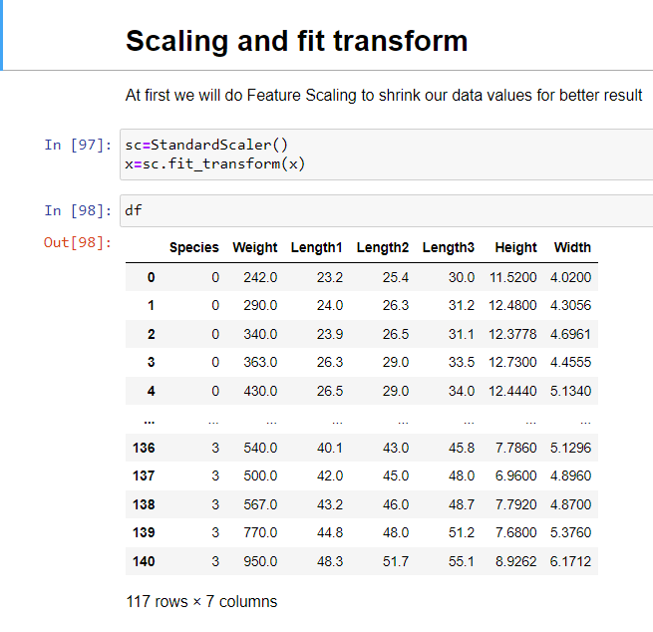
Using standard scaler to shrink our data for better result -

Slide 12
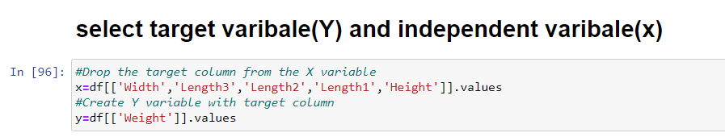
Model building -
x = independent variable
Y= dependent variable (target variable)
Note – here we are taking weight as target variable because in fishing industry weight of the fish plays very important role based upon weight only the price of the fish is fixed so here we are taking weight as target variable.

Slide 13
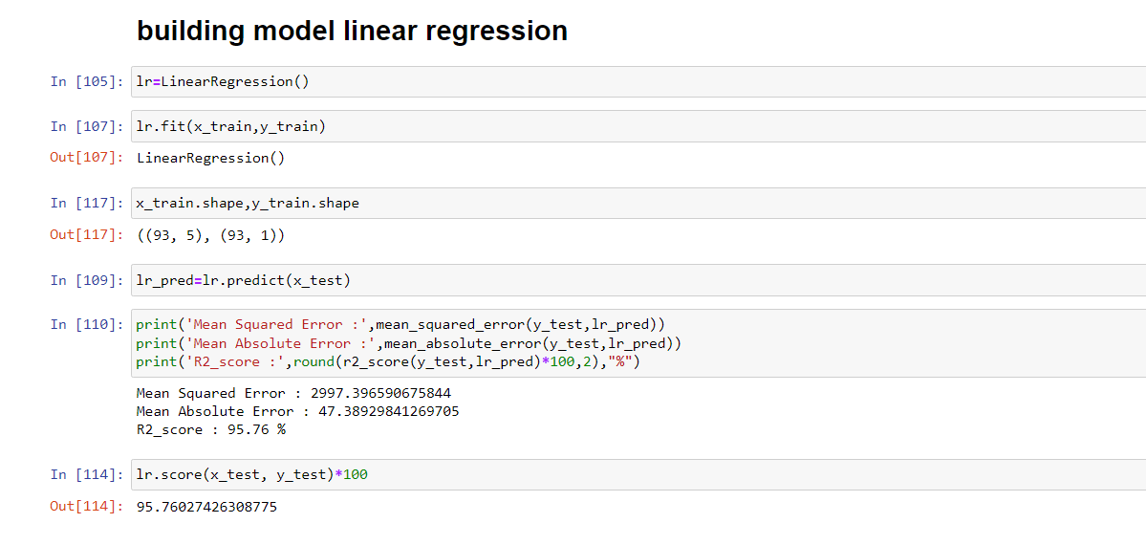
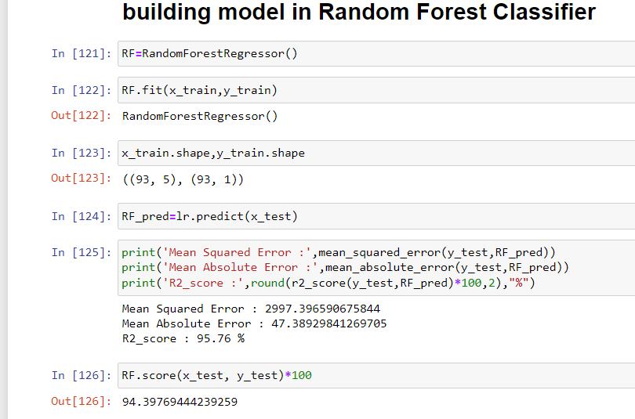
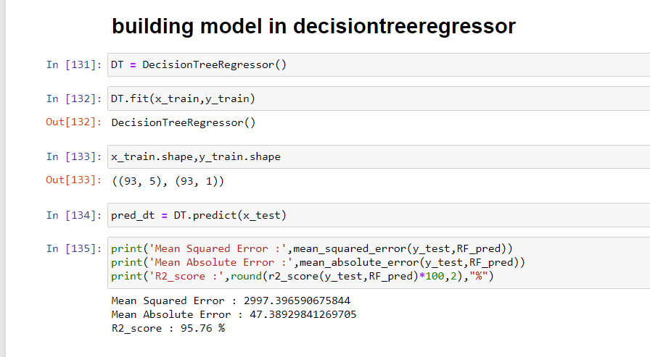
Building model with linear, decision tree & random forest -

Slide 14
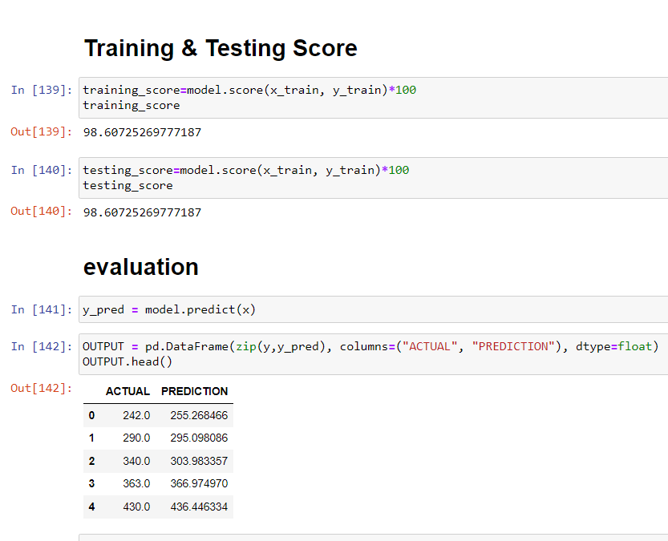
Seeing model performance -

Slide 15
Some of the drawn conclusion -
Relationship between variables: The regression analysis helps identify the relationship between the independent variables (such as length, weight, height, and width) and the dependent variable (fish measurements such as species, weight, or length). It provides insights into how changes in the independent variables impact the fish measurements.
Statistical significance: The regression analysis provides statistical measures, such as coefficients and p-values, to assess the significance of the independent variables in explaining the variation in fish measurements. A significant p-value indicates that the variable has a meaningful impact on the fish measurements.
->Predictive power: The regression model can be used to predict fish measurements based on the identified relationships. By inputting values for the independent variables, the model can generate predictions for the fish's species, weight, length, or other measurements.
Model evaluation: Various metrics, such as R-squared (coefficient of determination), adjusted R-squared, and root mean squared error (RMSE), can be used to evaluate the performance of the regression model. A higher R-squared value and a lower RMSE indicate a better fit of the model to the data.
->Assumptions: Regression analysis relies on assumptions, including linearity, independence of errors, homoscedasticity, and normality of residuals. It is important to assess these assumptions to ensure the validity of the regression model and the reliability of its predictions.
Limitations: Regression analysis has its limitations, such as the assumption of a linear relationship between variables, potential presence of multicollinearity, and the inability to capture all factors that influence fish measurements. Other external factors, such as environmental conditions, food availability, or genetic factors, may also impact fish measurements and should be considered in conjunction with the regression analysis.
It is important to note that the accuracy and reliability of the predictions depend on the quality of the data, the choice of independent variables, and the suitability of the regression model for the specific dataset. Regular model evaluation and updating based on new data are essential for maintaining accurate predictions. Additionally, it may be valuable to explore other modeling techniques, such as decision trees or neural networks, to compare their performance against the regression model.

